Slide 1
Real Estate Sales 2001-2020 GL
By Akosua krofa

Slide 2
Uncover insights into the accuracy of property assessments, identifying areas where adjustments may be necessary
The data shows that OPM remarks recorded 987,279 missing values and Assessor remarks recorded 847,349 missing values. This shows that there was no information on the assessment of some property types by the Office of Policy and Management and/ or by the assessor related to the property.
However the positive correlation between the Assessed values and Sales Amount gives indication that properties that had an assessed remark were sold at the appropriate price.
It is however necessary that each property is given an assessed value to ensure more accuracy in the figures recorded

Slide 3
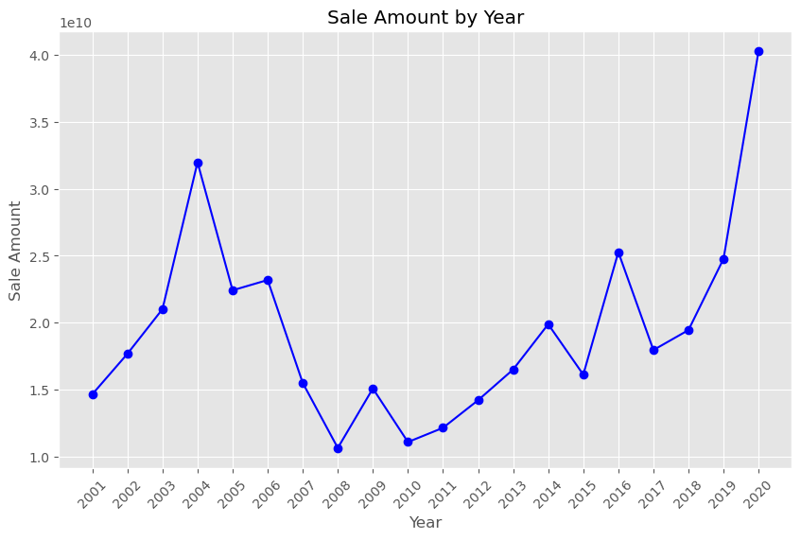
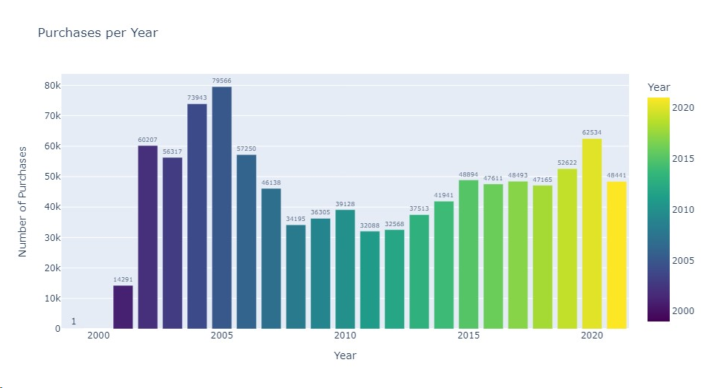
a nuanced understanding of market trends, allowing stakeholders to make informed decisions based on current and historical data
Generally the market trend shows that in years of financial and economic stability, more properties are sold and the sales amounts also tend to be higher. Entities producing properties should employ cost effective measures so as to increase affordability and reach a larger section of the populace.

Slide 4
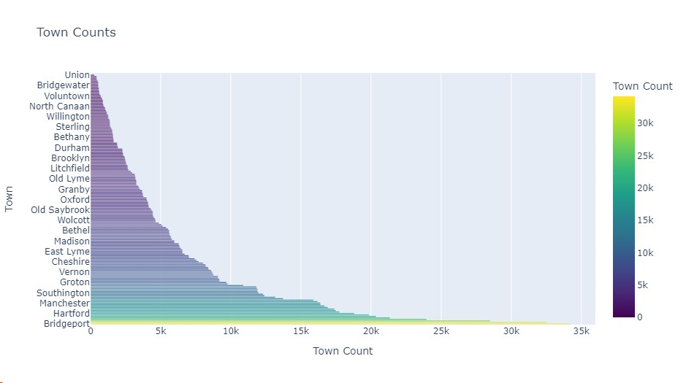
Provide localized insights for different towns, assisting in regional planning and investment decisions.
The graph below shows the distribution of the number of properties in each town listed as part of the data provided

Slide 5
Provide localized insights for different towns, assisting in regional planning and investment decisions
It is important for companies in the real estate sector to understand the dynamics of the population in each town they intend to erect new structures,
A young population with a large working class may suggest that residential facilities will be highly patronized whilst in brisk business towns a wider range of property types such as commercial, industrial and residential types may be largely considered
The graph in the previous slide shows the town of Bridgeport has the largest number of properties and this may indicate that there is a larger, more vibrant and economically active population in this area.
In contrast the town of Union recorded the least properties and this may indicate the town is less populated or may have an aging population implying less affordability.

Slide 6
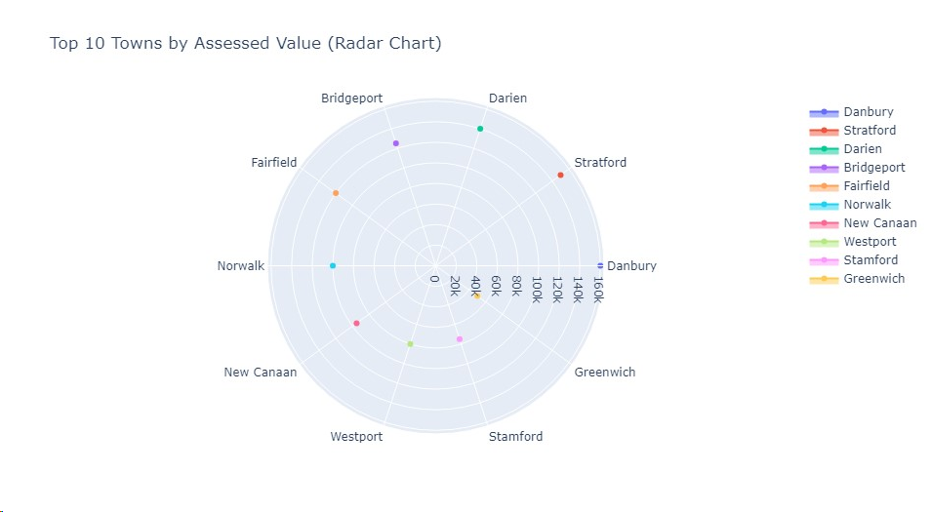
Provide localized insights for different towns, assisting in regional planning and investment decisions
The graph below shows the distribution of the top 10 towns by Assessed value as per the data provided – it can be seen that town of Bridgeport which recorded the largest number of properties has an assessed value $125,000 whereas Stamford which comes second in terms of the number of properties has an assessed value of $75,000. Danbury is recorded to have the largest Assessed value of $160,000 but has less properties than Bridgeport

Slide 7
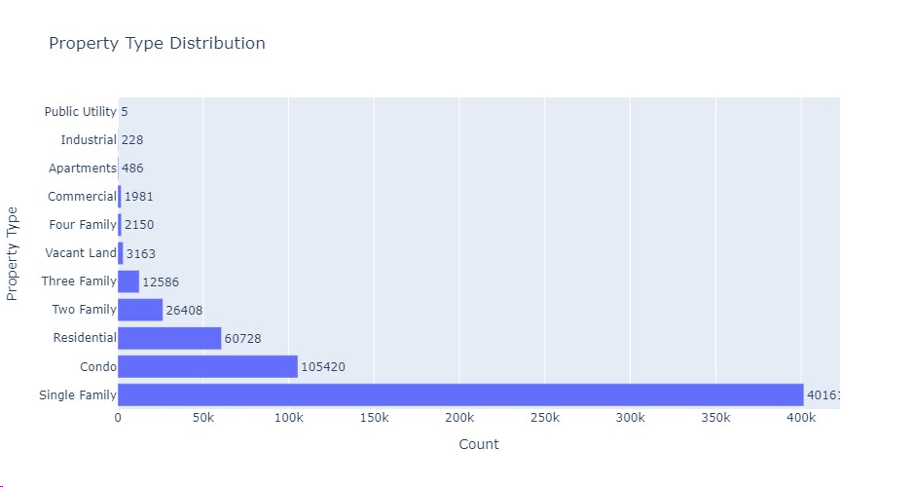
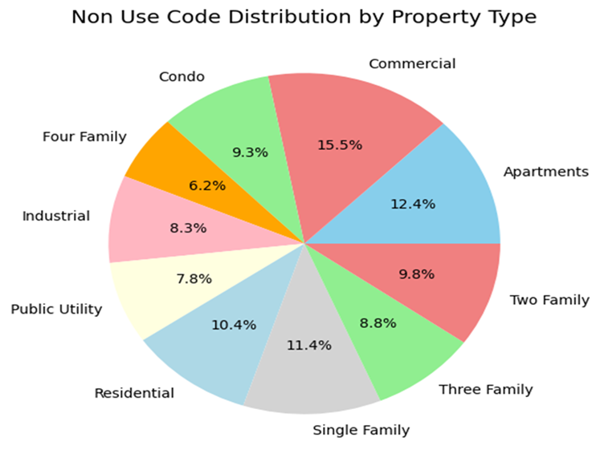
Understand the impact of property type on assessment outcomes, helping to tailor strategies for different segments of the real estate market
The below shows the property types and assessment by considering the non use codes associated with each property type

Slide 8
Investigate the role of non-use codes in property assessment, identifying patterns and potential areas for policy refinement
The graphs above show that the popular family type on the market is the single family property type. However the data shows that cumulatively commercial property types have the highest non use of 15.5% implying less patronage for this while the four family property type has the least non use of 6.2% indicating more person were interested in this property type. It would be profitable for the company to reduce its investment in the single family property type and channel this into the four family property type.
Again littles investment has been made in the public utility property type but this has a next least non use code after the four family property type – it is advisable for the company to invest more in public utilities as these are also well patronised

Slide 9
Utilize assessor and OPM remarks to improve communication and transparency in the assessment process
It is necessary that each property is given an assessed value to ensure more accuracy in the pricing of the properties
However the positive correlation between the Assessed values and Sales Amount gives indication that properties that had an assessed remark were assess correctly and the Office of Policy and Management (OPM) should be recommended on their good work.

Slide 10
Recommendations
It can be seen that among the property types, more of the single family property type was constructed as seen from the property count chart. Again, the public utility type was the least constructed and hence the least available on the market - this maybe as a result of high cost incurred for the construction. Interestingly from the non use code, the data shows that after the commercial property type, the single family property type is the next least patronized while the four family property type is most patronized as it has the least non use code. To increase revenue, price discrimination can be applied to the four family property type so this can be sold at a premium as there is high demand. On the other hand to encourage patronage of the commercial property type, discounts or promotions can be offered to make this property type more attractive.
The data shows that in 2005 the highest number of property purchases was recorded. From 2007 to 2017 the data records very low property purchase figures. This was the period where the effects of the global financial crisis was still being felt. This shows that in periods of financial instability the housing/property sector is negatively affected. As a precautionary measure - flexible payment structures can be put in place during times of financial instability to encourage patronage. Moratorium on repayment can also be introduced to give housing owners a financial breather
It is advised that the company assesses the structure of the populace of each town before investing in any particular type. The structure of the population should inform the type of property to be invested in

